Slide 1
R Introduction
Dr. Lisa Biber-Freudenberger
With inputs from Johannes Schielein and Quick R

Slide 2
About Me
Bachelor in Biology 2006
Master in international Nature Conservation 2009
Doctoral Degree Priority Setting in Nature Conservation Planning 2012
At ZEF as a Senior Researcher in WASCAL since 2013
Now in Project STRIVE (Sustainable TRade and InnoVation transfer in the bioEconomy: from national strategies to global sustainable development goals) launched Oktober 2016

Slide 3
Course Content
What is R?
Advantages and disadvantages of R
How does R Work ?
Fundamentals of R Scripting

Slide 4

What is R ?
“R is a language and environment for statistical computing and graphics.
…
The term “environment” is intended to characterize it as a fully planned and coherent system, rather than an incremental accretion of very specific and inflexible tools, as is frequently the case with other data analysis software.
…
R … is designed around a true computer language, and it allows users to add additional functionality by defining new functions. “
Source: https://www.r-project.org/about.html

Slide 5
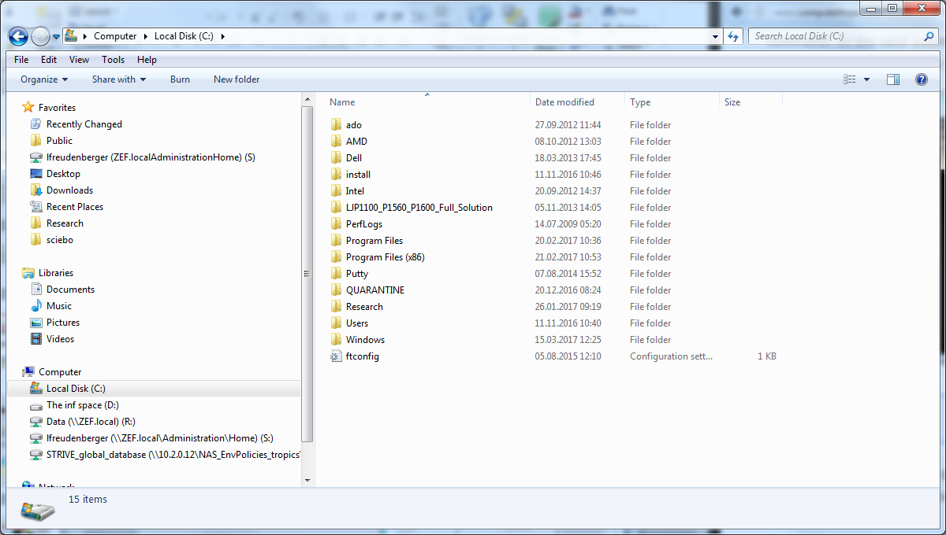
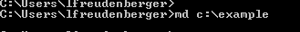
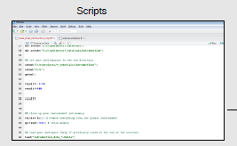
What is R ?
Programming vs. Clicking
Scripts can contain thousands of written commands
Source: Adapted from Lecture Johannes Schielein

Slide 6
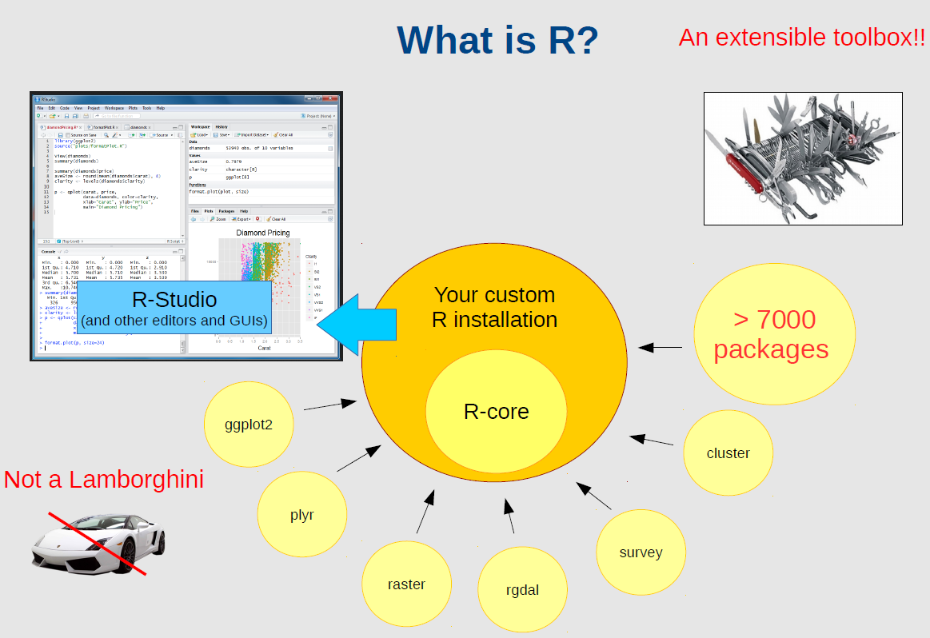
What is R?
Source: Lecture Johannes Schielein

Slide 7
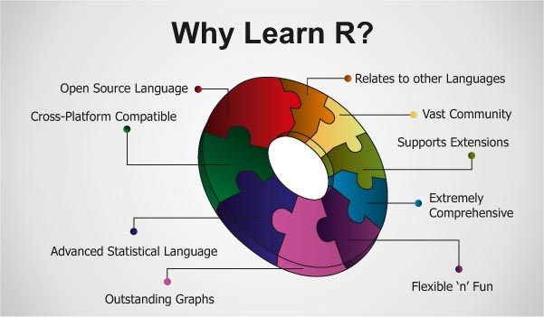
Why R?
Free of Charge
Transparent
Decentralized
Comprehensive
Source: http://bigdatahadooppro.com

Slide 8
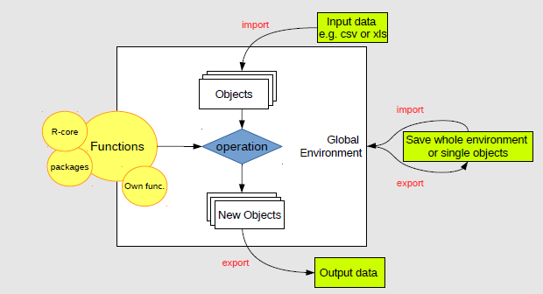
Object oriented programming in R
Source: Lecture Johannes Schielein

Slide 9
Most important object classes
Numeric
Double (decimal values, e.g. 2.54
Integer (integral values, e.g. 12)
Logical (conditional values indicating true or false, e.g. 2<10
Character (string values e.g. „green“)
Factor (characters representing categorical data e.g. male and female)

Slide 10
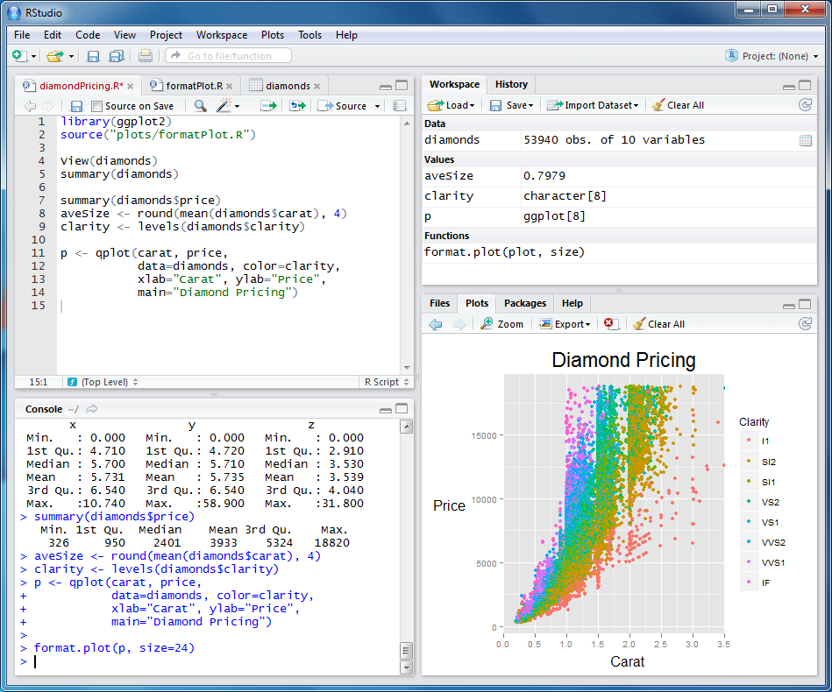
Working with R-Studio
Global Environment: Here you can see all created objects.
Script: Always use a script to be able to repeat your results
Console:
Execute your script in the console.
Plots, packages, help and others.
Adapted from Lecture Johannes Schielein

Slide 11
Important Short Cuts in R and R-Studio
Cntrl+R: Execute current line
Highlight + Cntrl: Execute all that has been highlighted
#This is a comment: Comments in the script are not executed
Tab: Autocompletion

Slide 12
Naming Convention in R
Do not use special characters or operators (e.g. $&§!=*+-/)
Do not use only Numbers (e.g. 2010)
Separate words with underscores (_) or dots (.) not with spaces
Choose between alllowercase (variablerain) OR lowerCamelCase (variableRain) OR UpperCamelCase(VariableRain) BUT be consistent

Slide 13
R Introduction
Topic | Code | Description
Arithmetic Operators | > 2+3 [1] 5 | “>….” is a command line, “[1]5” is the output
Objects | > a=2+3 > a [1] 5 | Assign 2+3 to “a” You may use a “<-” instead of a “=“
 | >ls() >rm(list=ls()) | List all your objects Remove all your objects
Vectors | > b=c(2,3,4) > b [1] 2 3 4 | Create a vector with the function “c” that combines arguments into a vector or a list
Logical Operators | >a<=3 TRUE b<=3 TRUE TRUE FALSE | With logical operators you can if a certain condition applies.
Functions | > c=sum(b) > c [1] 9 | Functions have been implemented to make your life easier e.g. to sum the values of a vector

Slide 14
Task - Objects
Estimate your average working hours per day and store it as a new object
Estimate the number of days you will be working on your PhD thesis (or something else) and save it as a new object
Use both objects to estimate how many hours you will „torture“ yourself in order to get your Phd and save the results as a new object
Calculate your opportunity costs for doing a Phd by comparing your actural salary to alternative salaries you could obtain during that time. Again save the results as new object.
What do you think about the results? Save your thoughts as a character string

Slide 15
Vectors
Topic | Code | Description
Vectors - Creation | > v1 <-c(1,2,3,4,5) > v1 [1] 1 2 3 4 5 | Create a vector with “c”
Vectors - Indexing | > v1[2] [1] 2 > v1[2]=4 > v1 [1] 1 4 3 4 5 | Call the second value of the vector Replace the second value
Vectors – Automated Creation | > v2=seq(from=1 , to=2, length=5) > v2 [1] 1.00 1.25 1.50 1.75 2.00 | Create a vector with 5 values ranging between 1 and 2 (equal steps)
Vectors - Operations | > v3=v1+v2 > v3 [1] 2.00 5.25 4.50 5.75 7.00 | Sum the values of vector 1 and vector 2

Slide 16
Task - Vectors
Create a vector with the length 50 and numbers between 0 and 5
Create a second vector with the length 50 and numbers between 100 and 150
Subtract the first vector from the second vector.
What is the 23rd value of the resulting vector?

Slide 17
Data Frames
Topic | Code | Description
Data Frames - Creation | > df = data.frame (A = c(“one“, “two“, “three“), B = c(4,5,6), C = c(7,8,9)) > df A B C 1 one 4 7 2 two 5 8 3 three 6 9 | Data frames are similar to matrices data types can be different e.g. numbers and strings With row.names=c(…) you can also add row names
Data Frames- Indexing | > df[,2] [1] 4 5 6 > df$B [1] 4 5 6 | Indexing can be done by numbers or names
Add column to dataframe | df$D<-c(“green“,“red“,“blue“) | Add a column to a dataframe by simply naming it and adding the content
Delete column from dataframe | df$D<-NULL
Attributes | >attributes(df) | “attributes” returns a list of attributes and is helpful to understand how objects are structured

Slide 18
Most important object types
Scalar
Vector
Dataframe (Matrix)
List
…
209
209
305
409
508
962
6
826
85
61
635
…
Name | Sex | Age
Bernd | Male | 31
Clara | Female | 16
Johannes | Male | 23
Lara | Female | 19
James | Male | 63
Dennis | Male | 12
Name | Sex | Age
Bernd | Male | 31
Clara | Female | 16
Johannes | Male | 23
Lara | Female | 19
James | Male | 63
Dennis | Male | 12
Name | Sex | Age
Bernd | Male | 31
Clara | Female | 16
Johannes | Male | 23
Lara | Female | 19
James | Male | 63
Dennis | Male | 12
Name | Sex | Age
Bernd | Male | 31
Clara | Female | 16
Johannes | Male | 23
Lara | Female | 19
James | Male | 63
Dennis | Male | 12
Name | Sex | Age
Bernd | Male | 31
Clara | Female | 16
Johannes | Male | 23
Lara | Female | 19
James | Male | 63
Dennis | Male | 12
Name | Sex | Age
Bernd | Male | 31
Clara | Female | 16
Johannes | Male | 23
Lara | Female | 19
James | Male | 63
Dennis | Male | 12
Name | Sex | Age
Bernd | Male | 31
Clara | Female | 16
Johannes | Male | 23
Lara | Female | 19
James | Male | 63
Dennis | Male | 12

Slide 19
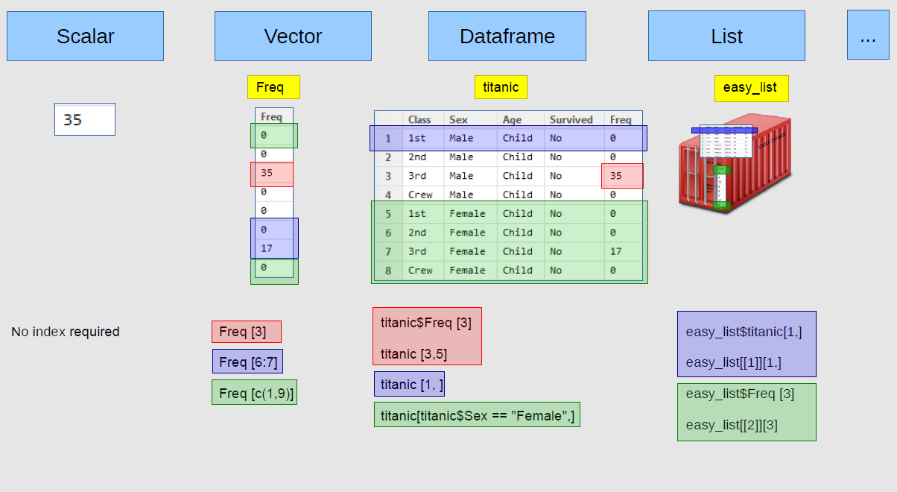
Indexing

Slide 20
Task Data Frames
Imagine you would go for a beer after this course and there was a Bar Quiz that you'd like to win. Choose five persons from this room who you could imagine to be your team members.
Create a new data-frame containing the following information about these persons
Unique ID (e.g. 1,2,3,4,5)
Country of origin (string) – try to guess!
Age (numeric) – try to guess!
Average grade in high-school graduation (numeric, 1-10 where 10 is the highest) - try to guess!
Calculate the average from your age guesses. (HINT: the name of the function is “mean”)
Add a new column to the data-frame with a logical vector (TRUE/FALSE) indicating whether your guess for the persons average high-school graduation grades exceeds or equals the average grade or not.

Slide 21
Packages, Working Directory and Help
Topic | Code | Description
Download, install and load packages into R | >install.packages(“raster”) > library (raster) | Functions are combined in so-called “packages” “library“ and “require” can both be used to load the package
Working directory | > setwd("C:/Users/….") > getwd() [1] "C:/Users/….“ >list.files() | Get and set the working directory The working directory is the Default location for import and export List the files of your working directory
Get Help | >?sum >help(sum) >??sum | Use “??” if you have not loaded the package with the function. In some GUIs it is also possible to get help in the console by hitting TAB (in R-Studio)

Slide 22
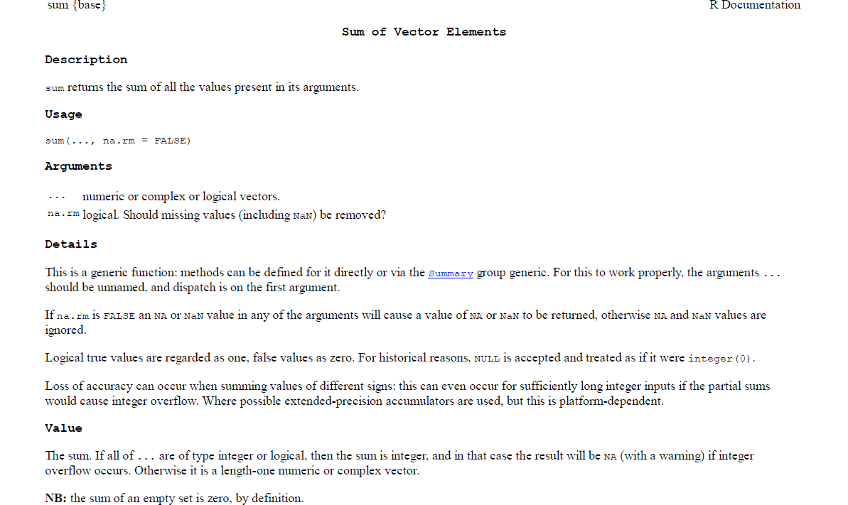
How does the help of R look like?
Function{Package}
Function(Arguments)
Output

Slide 23
Data Import & Export of spreadsheet data
Topic | Code | Description
Data import from spreadsheets e.g. from csv files | data<- read.table(file=“file.csv“, head=TRUE,sep=",") | Data import from your working directory; with sep= you can indicate which separator for columns you are using e.g./t for tabs. head= TRUE indicates that your first row contains the column headers, with dec=“.“ you can specify your decimal seperator
Data export to spreadsheets e.g. to csv file | write.table(data,file=„file.csv“, sep=“,“) | Data export to your working directory as csv file
Data import from Excel | library(xlsx) data <- read.xlsx("c:/myexcel.xlsx", 1) mydata <- read.xlsx("c:/myexcel.xlsx", sheetName = "mysheet") | Direct data import from excel file of first worksheet or worksheet named “mysheet“
Data export to Excel | write.xlsx(data, "c:/mydata.xlsx") | Export to excel spreadsheet

Slide 24
Task Export/Import
Create a folder on your computer, which you want to be the working directory.
Set your working directory in R to the directory above and control if it worked.
Export your dataframe from the previous task to your working directory as a csv file
Reimport the file

Slide 25
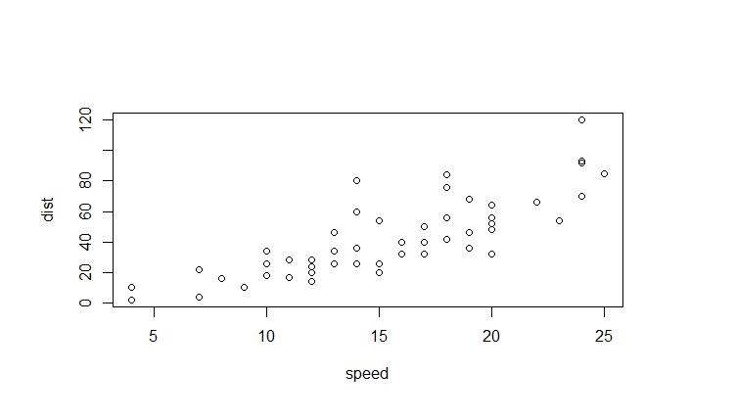
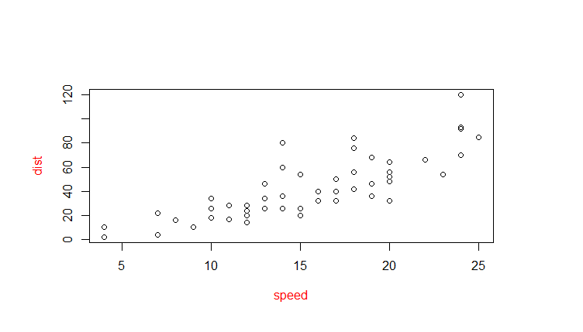
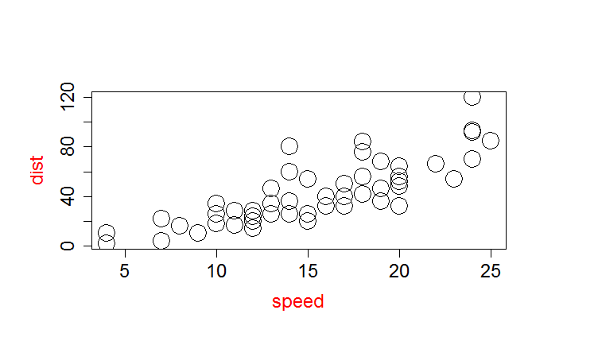
Setting Parameters
In R | Explanation
plot(cars) | Make a simple plot with default settings
plot(cars, col.lab="red") | set options within plotting function or
par() | Returns the current settings
opar<-par() par(col.lab="red") plot(cars) par<-(opar) | set graphical parameters with par but do not forget to safe your original settings
Sizing of symbols and text
plot(cars,col.lab="red",cex=3, cex.axis=1.5,cex.lab=1.5) | “cex” indicates the amount by which plotting text and symbols should be scaled relative to the default. 1=default, 1.5 is 50% larger, 0.5 is 50% smaller, etc. “cex.axis” magnification of axis annotation “cex.lab” magnification of x and y labels “cex.main” magnification of titles relative “cex.sub” magnification of subtitles

Slide 26
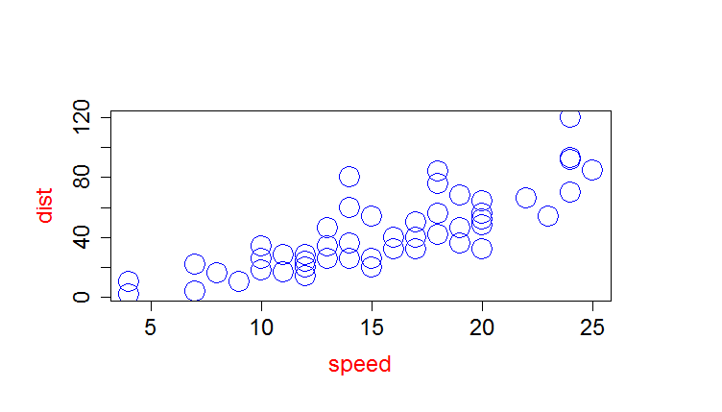
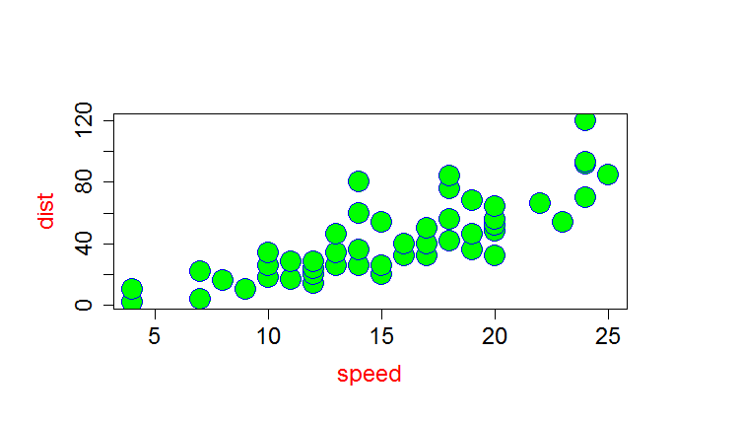
Setting Parameters cont…
In R | Explanation
Colors and Symbols
plot(cars,col.lab="red",cex=3, cex.axis=4,cex.lab=2, col="blue") colors() | “col” set plotting color “col.axis“ color for axis annotation “col.lab“ color for x and y labels “col.main“ color for titles “col.sub“ color for subtitles colors() returns all available colors Specify colors by index (col=1), name col=“white”, hexadecimal (col="#FFFFFF“), or RGB (col=rgb(0,0,0)).
?pch plot(cars,col.lab="red",cex=3, cex.axis=1.5,cex.lab=1.5, pch=21, col="blue", bg="green") | “pch” sets symbols “fg“ foreground color “bg“ background color

Slide 27
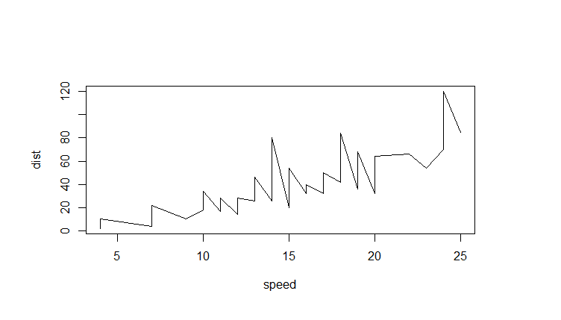

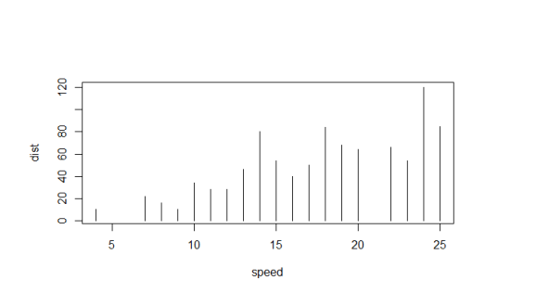
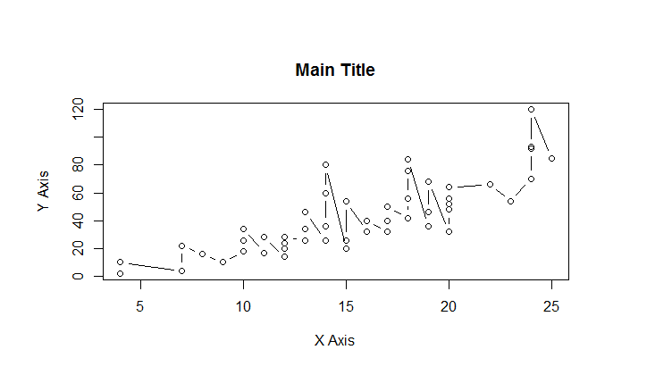
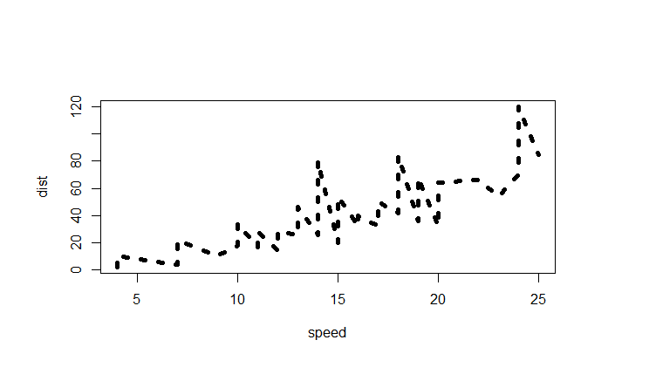
Setting Parameters cont…
In R | Explanation
Plot types, axis labels and line width
plot(cars, type="l") plot(cars, type="b") plot(cars, type="h") | Plot lines Plot lines and points Plot histogram
plot(cars, type="l", lty=3, lwd=5) | lty sets the line type; lwd sets the line width
plot(cars, type="b", main="Main Title", sub="Subtitle", xlab="X Axis", ylab="Y Axis") | Set labels of the x and y axis

Slide 28
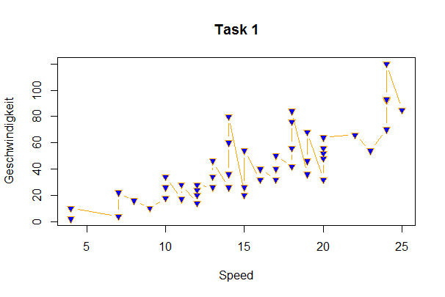
Task- Simple Plots
Make a plot that looks like this:

Slide 29
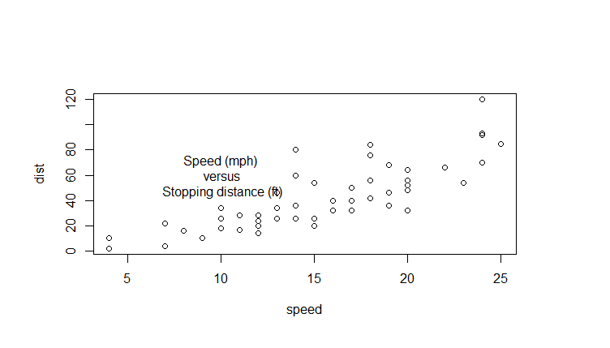
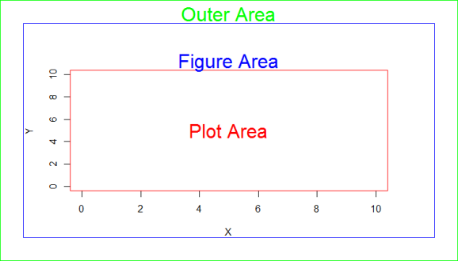
Setting Parameters cont…
In R | Explanation
Positions of elements within the plot and margins
plot(cars) text(10, 60, "Speed (mph)\n versus\n Stopping distance (ft)") | Add text to a plot with text(x-pos,y-pos,”text”)
plot(0:10, 0:10, type="n",xlab="X", ylab="Y") text(5,5,"Plot Area",col="red", cex=2) box(col="red") box(which="figure", col="blue") mtext("Figure Area", cex=2, col="blue") | Draw a plot with x and y axis from 0 to 10 Add text to the Plot Area box the plot area with the same colour Draw a box around the figure Add a text to the marginal area
par()$mar par(mar=c(4, 4, 4, 4)) par()$oma par(oma=c(2,2,2,2)) box(which="outer", col="green“, cex=1) mtext("Outer Area", cex=2, outer=TRUE, col="green") | Get the current margin settings Set margin sizes with mar Set outer margin size with oma Box outer area with green and add text to it

Slide 30
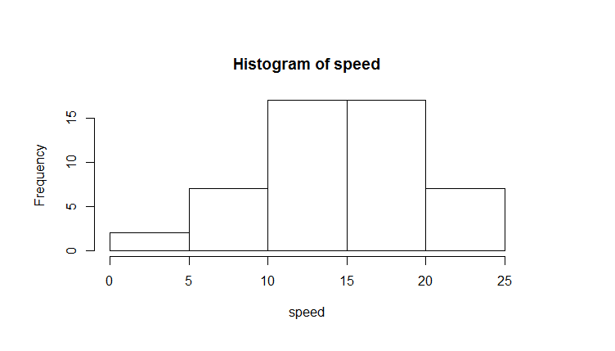
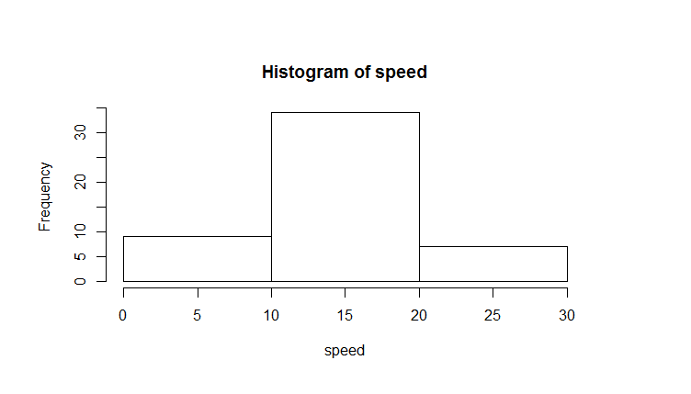
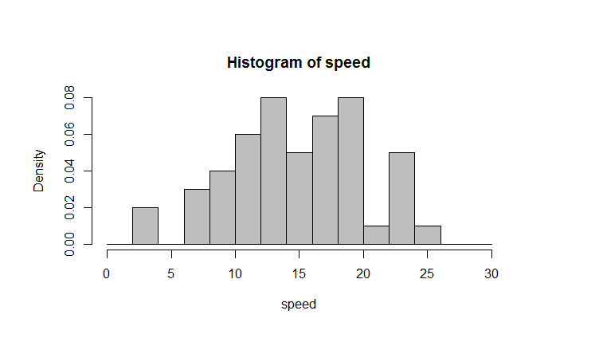
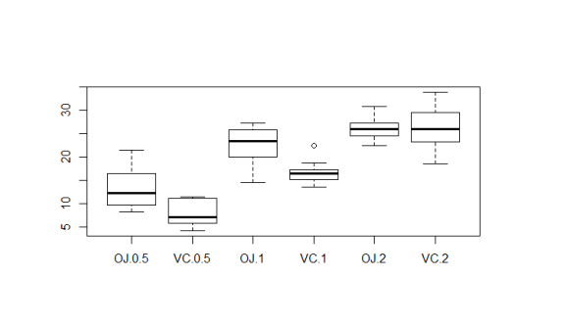
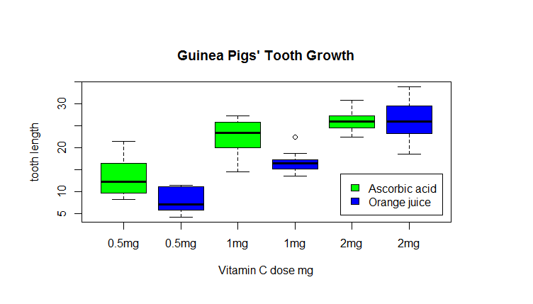
Different types of plots
In R |  | Explanation
Histograms
hist(cars$speed) hist(cars$speed, breaks=seq(from=0,to=30,10)) hist(cars$speed, breaks=seq(from=0,to=30,2), col="grey", freq=FALSE) | Hist plots a histogram Set breaks with by defining a sequence Switch from frequency to density histogram with freq=FALSE
Boxplots
boxplot(ToothGrowth$len~ToothGrowth$supp*ToothGrowth$dose) | Boxplot creates a boxplot with groups according to the supplement factor
boxplot(ToothGrowth$len~ToothGrowth$supp*ToothGrowth$dose, col=c("green", "blue"), main = "Guinea Pigs' Tooth Growth", xlab = "Vitamin C dose mg", ylab = "tooth length", xaxt="n") axis(1,at=seq(1:6),labels=c("0.5mg","0.5mg","1mg", "1mg","2mg","2mg")) legend(4.8, 14, c("Ascorbic acid", "Orange juice"), fill = c("green", "blue")) | Set different parameters of a boxplot Add a customized axis Add a legend

Slide 31
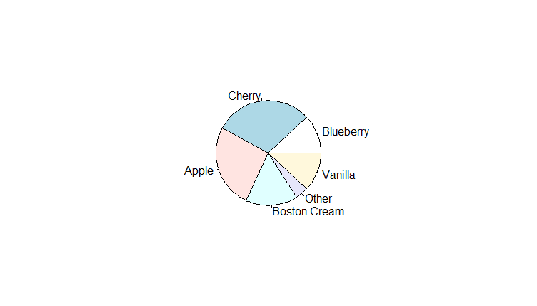
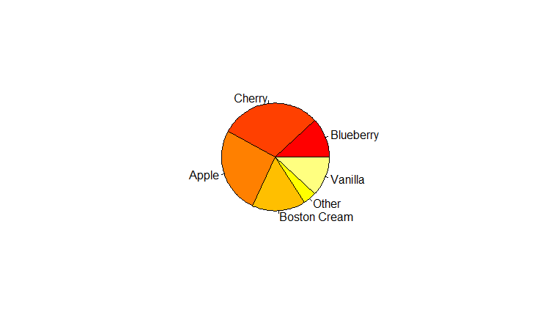
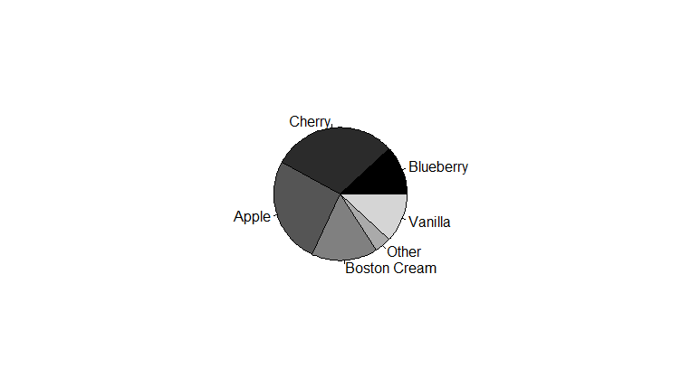
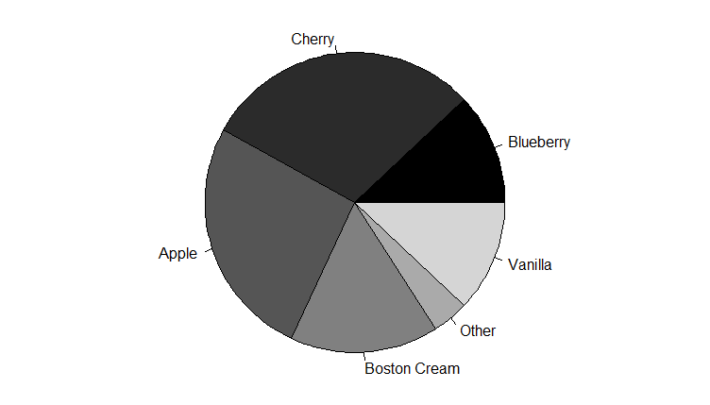
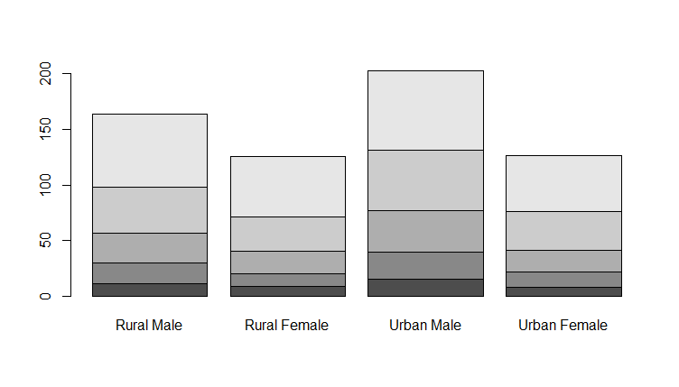
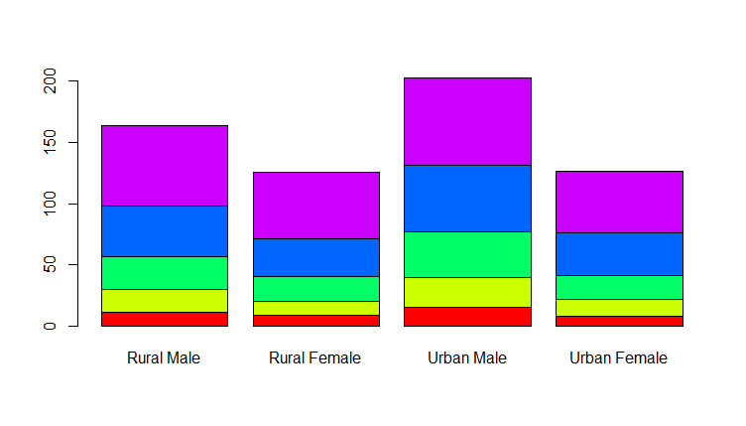
Other types of plots cont…
In R | Explanation
Pie Charts
sales <- c(0.12, 0.3, 0.26, 0.16, 0.04, 0.12) names(sales) <- c("Blueberry", "Cherry", "Apple", "Boston Cream", "Other", "Vanilla") pie(sales) | Create a vector with the data Define the “names” of the data Create a pie chart with the numbers from sales
pie(sales, col= heat.colors(6)) pie(sales, col = gray(0:6/6)) par(oma=c(0,0,0,0), mar=c(0,0,0,0)) pie(sales, col=gray(0:6/6)) | create color vectors with function rainbow(n), heat.colors(n), terrain.colors(n), topo.colors(n), and cm.colors(n). create color vectors with function gray
Barplots
barplot(VADeaths) barplot(VADeaths, col=gray(seq(0.3,0.7,0.1))) barplot(VADeaths, col=rainbow(5)) | Create barplots

Slide 32
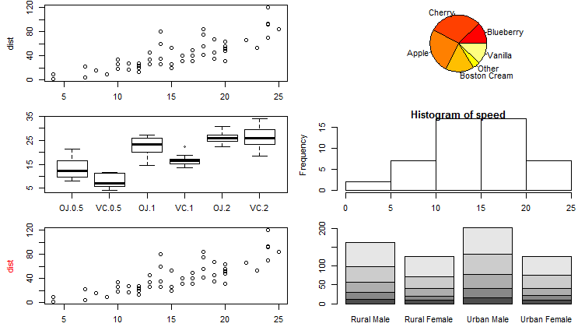
Multiple Plots on one page
In R | Explanation
par(mfrow=c(3,2),mar=c(3,4.5,0.5,0.5), oma=c(0,0,0,0)) plot(cars) pie(sales, col= heat.colors(6)) boxplot(ToothGrowth$len~ToothGrowth$supp*ToothGrowth$dose) hist(cars$speed) plot(cars, col.lab="red") barplot(VADeaths) | Set the number of columns and rows with mfrow and plot the different plots in the order to display.

Slide 33
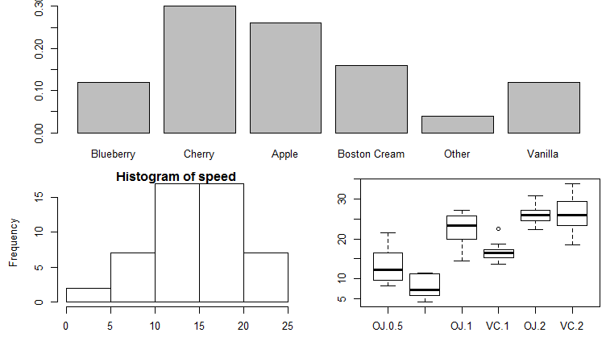
Multiple Plots on one page cont…
In R | Explanation
layout(matrix(c(1,1,2,3), 2, 2, byrow = TRUE)) layout.show(3) barplot(sales) hist(cars$speed) boxplot(ToothGrowth$len~ToothGrowth$supp*ToothGrowth$dose) | layout(mat) with mat as a matrix object specifying the location of the figures to plot. Plot one figure in row 1 and two figures in row 2

Slide 34
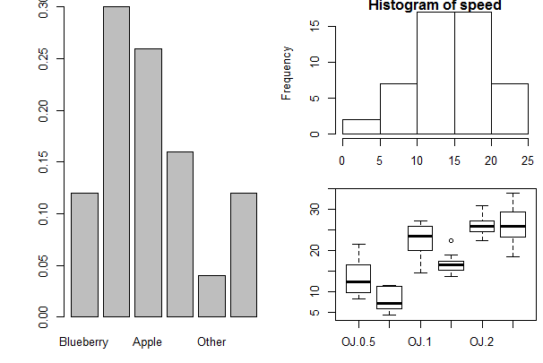
TASK – Multiple Plots
Make a plot that looks like this

Slide 35
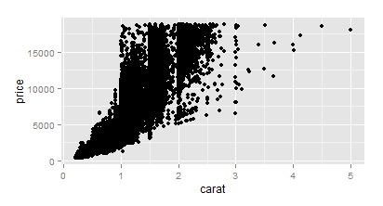
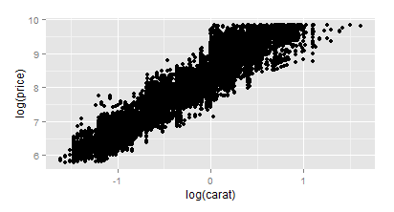
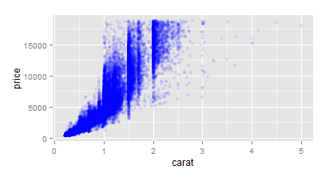
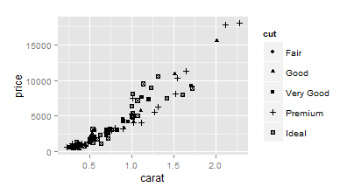
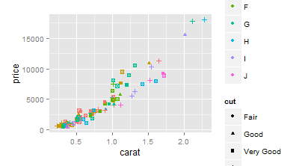
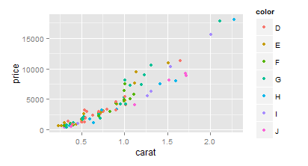
The ggplot2 package
In R | Explanation
qplot(carat, price, data = diamonds) | qplot can be used to create the most comon plot types e.g. scatterplots (default)
qplot(log(carat), log(price), data = diamonds, alpha=0.2) | qplot accepts formula arguments such as log
qplot(carat, price, data = diamonds, alpha=I(0.1), colour=I("blue")) | Set parameters manually with I()
dsmall <- diamonds[sample(nrow(diamonds), 100), ] qplot(carat, price, data = dsmall, colour = color) qplot(carat, price, data = dsmall, shape = cut) | Create a sample Plot with different colours for color Plot with different shapes for cut

Slide 36
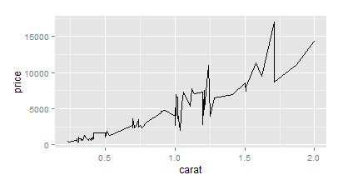
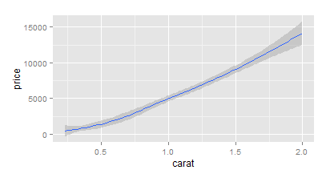
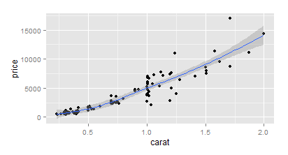
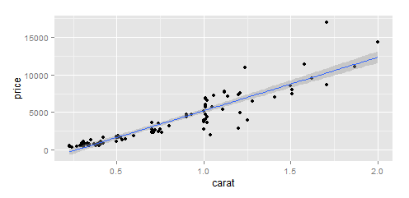
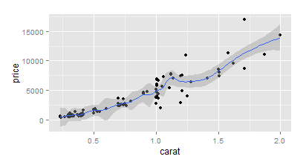
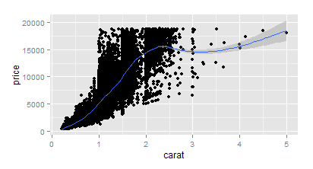
The ggplot2 package
In R | Explanation
qplot(carat,price,data=dsmall, geom="line") qplot(carat,price,data=dsmall, geom="smooth") qplot(carat,price,data=dsmall, geom=c("point","smooth")) | With “geom” different types of plots can be defined e.g. points, line, boxplot, path, smooth. These can also be combined in a vector.
qplot(carat,price,data=dsmall,geom=c("point","smooth")) qplot(carat,price,data=diamonds,geom=c("point","smooth")) | Depending on your dataset size the smooth function will select different methods that can be changed through method.
qplot(carat,price,data=dsmall, geom=c("point","smooth"), span=0.2) | With span the wiggliness of the line is controlled.
qplot(carat,price,data=dsmall,geom=c("point","smooth"),method="lm") | Use method to specify your smoothing method

Slide 37
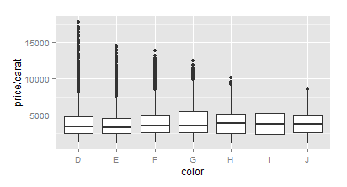
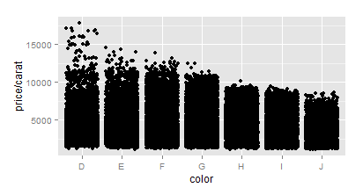
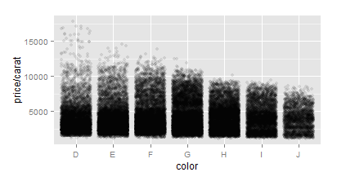






The ggplot2 package
In R | Explanation
qplot(color,price/carat,data=diamonds, geom="boxplot") qplot(color,price/carat,data=diamonds, geom="jitter") qplot(color,price/carat,data=diamonds, geom="jitter", alpha=I(0.1)) | Boxplots can be displayed through geom=“boxplot”. Jittered plots (geom=“jitter”) show all points. In case of overplotting changing alpha can help.
qplot(carat, data = diamonds, geom = "density") qplot(carat, data = diamonds, geom = "density", colour = color) qplot(carat, data = diamonds, geom = "density", fill = color, alpha=I(0.3)) | Histograms can be displayed through geom=“histogram”.
qplot(carat, data = diamonds, geom = "density") qplot(carat, data = diamonds, geom = "density",colour = color) qplot(carat, data = diamonds, geom = "density", fill = color, alpha=I(0.3)) | Density plots can be displayed through geom=“density”,

Slide 38


The ggplot2 package
In R | Explanation
qplot(displ, hwy, data = mpg, colour = cyl, geom=c("point","smooth"),method="lm") qplot(displ, hwy, data = mpg, colour = factor(cyl), geom=c("point","smooth"),method="lm") | Use factor to subset your data

Slide 39
Task – Play around with R
Use R as much as possible and if possible for projects without time pressure
Don´t copy and paste. Try to understand the code.
Make tutorials, google, create forum accounts…
Don´t get frustrated!

